Slide 1
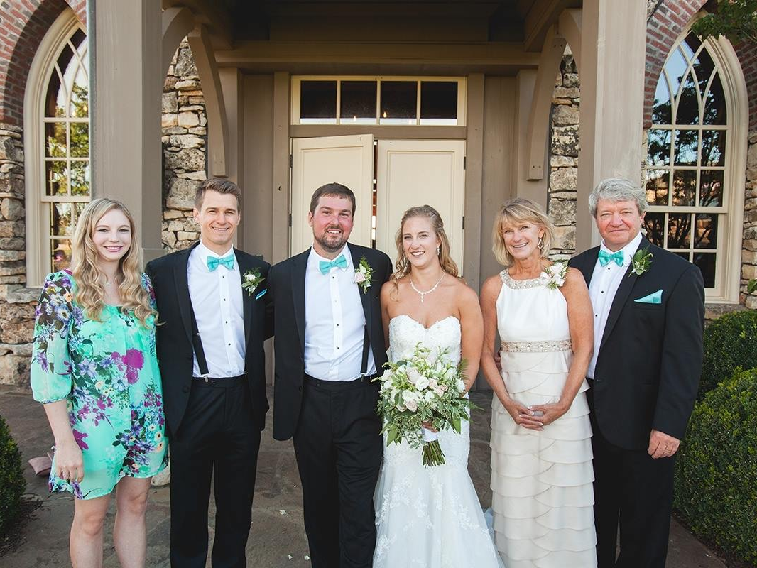
My family

Slide 2
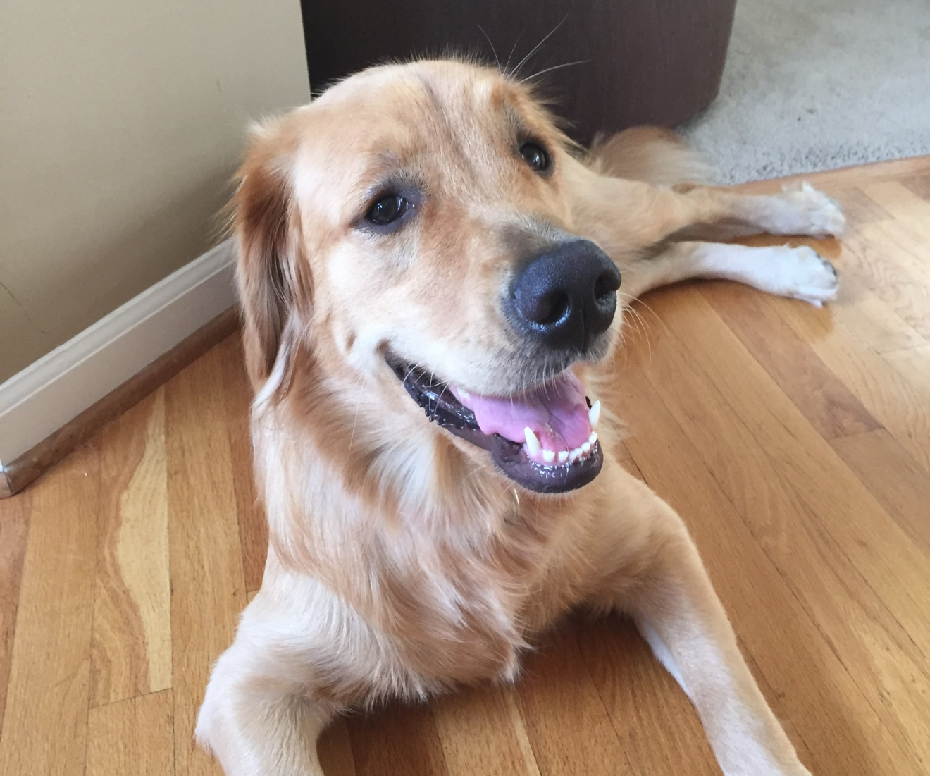
Brandi

Slide 3
Mrs. Brettmann’s Schedule
8:35-9:05 Journal
9:05-9:30 Calendar/ Morning Meeting
9:30-10:00 Whole Group Reading (ELA)
10:00-10:15 Recess
10:20-10:55 (M) Fine Motor (T) Counselor/Mystery Reader (W)Writer’s Workshop (TH) Library (F) Science/Social Studies
11:00-11:30 Lunch
11:30-12:30 Math
12:30-1:30 Specials
1:30-2:30 Literacy Centers/Intervention
2:30-2:40 Snack
2:40-2:55 Recess
3:00-3:25 Centers
3:25-3:30 Pack up
3:35 Dismissal

Slide 4
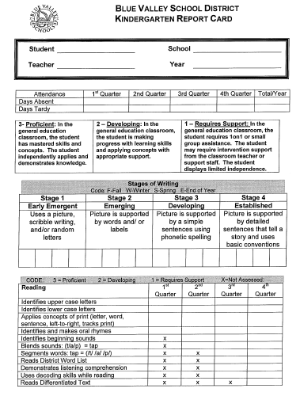
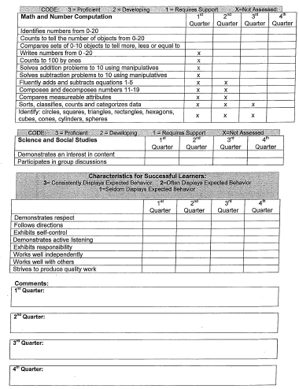

Slide 7
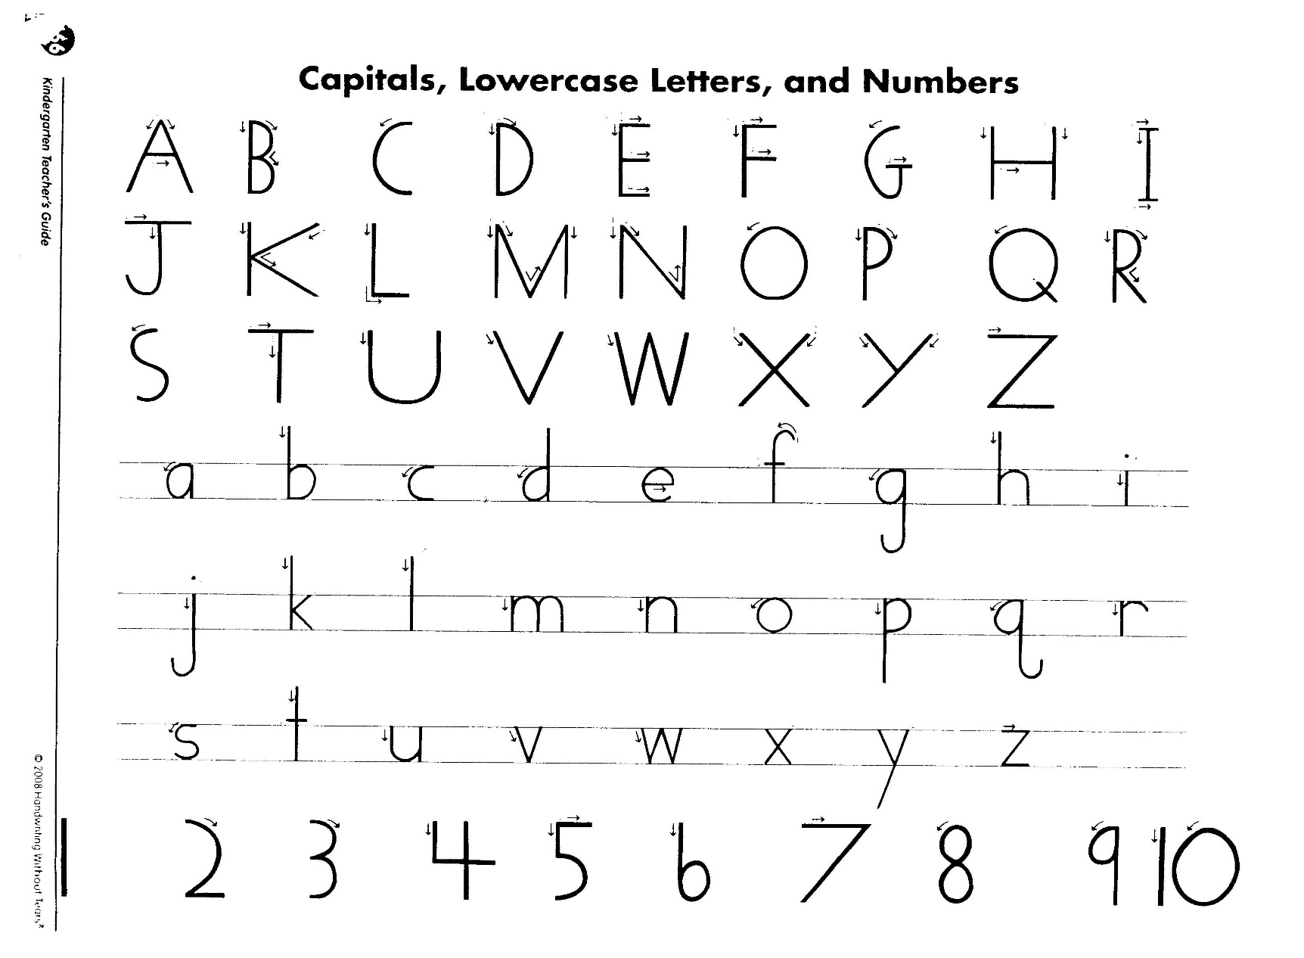
Handwriting Without Tears

Slide 8
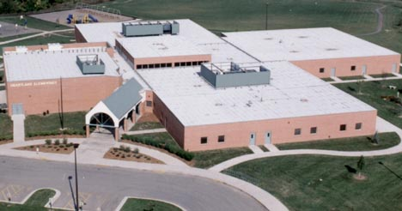
Heartland Elementary
2017-2018 Kindergarten Team

Slide 9
The ABC’s of Kindergarten

Slide 10
A
A successful Kindergartener is one who has the support of school and home through open communication.

Slide 11
B
Birthdays
We try to make each student’s birthday special. Heartland is now a food free celebration school. We will recognize your child’s birthday with a birthday crown, pencil, and certificate.
Book Orders
We will send home a scholastic book order each month and you have the option to purchase books.
Behavior Plan – Conscious Discipline

Slide 12
C
Centers
We use centers in the classroom where your child has the opportunity to work and play with other children while being engaged in a variety of skills. Center time will be 25 minutes for the full day program. Teachers use this time to provide individualized or small group instruction and for assessments.

Slide 13

D
D Please designate an area for your child’s school belongings, such as backpack, library books, yellow Go folder, take home reader envelope, and other items. This organization will help you get out the door in the morning and help your child become a responsible kindergartener.

Slide 14
E
EnVision is the math series we teach in Blue Valley. Your child will learn numbers to 100, addition, subtraction, measurement, and shapes. We will meet in large groups and small guided math groups.

Slide 15
F
Field Trips
We will go on 3 field trips this year.
November 8–Kaleidoscope
Dec. 12 –Wilderness Science Center
May 9 – Coterie Theater
  We will need parent helpers on these field trips. All students are transported by bus, no private cars. Younger siblings may not attend due to insurance precautions.

Slide 16
G
Go Folders
Students will bring home a yellow Go folder each day. This is a way of communicating with parents. The folders have graded papers, important notices, etc. Please be sure to return it daily. Parents should use it to send notes to the teacher or office.

Slide 17
H
Homework
It is important to establish a responsible homework routine at this age. Homework may include the Home/School Kindergarten Program, math pages if a student needs extra help, and reading 10 minutes daily.

Slide 18
I
Invented Spelling
This is what much of the writing in kindergarten looks like. We write in our journals almost every morning. Students will write what they hear. Example: Journal – jrnl; book-buk…… It is amazing how their skills progress over the school year.

Slide 19
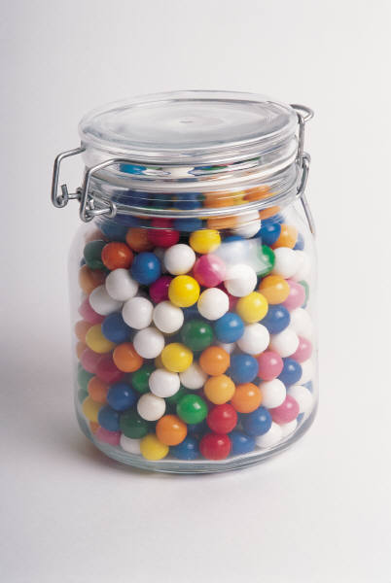
J
Jar for guessing (Estimation)
Each Friday a child will bring home the guessing jar to fill with any item he chooses. He/she should bring it back to school on Monday. The children will then estimate the number of items. We count the items in groups of tens to see how close we all guessed. If a child chooses to bring an item to share with the class, he/she must bring enough for everyone.

Slide 20
K
Kindergarten is a special time for your child. We want to make this the best experience possible. Your child will grow and change emotionally, socially, physically, and cognitively.

Slide 21

L
Label all personal items your child brings to school: water bottles, lunch box, backpack, coats, and sweatshirts. There is no need to label school supplies, as we put them in community buckets.
Library is every Thursday. Kindergarten students check out two books every week. Library books are due the following week. Students may not check out another book until the original book is returned. Please make sure water bottles do not damage your child’s library books.

Slide 22
M
Mystery Reader
Each Tuesday at 10:45 a Mystery Reader (you, grandparent, older sibling, etc.) comes to the classroom to read to the children. Please be sensitive to our diverse population and choose a book your child’s teacher would be comfortable using in the classroom.

Slide 23
N
Nuts
DUE TO NUT ALLERGIES, ALL SNACKS SHOULD BE LISTED ON THE NUT-SAFER LIST.

Slide 24
O
Outside -Your child will have outdoor recess every morning and afternoon, weather permitting. Please dress your child appropriately for the weather and remember to label all your child’s belongings.

Slide 25
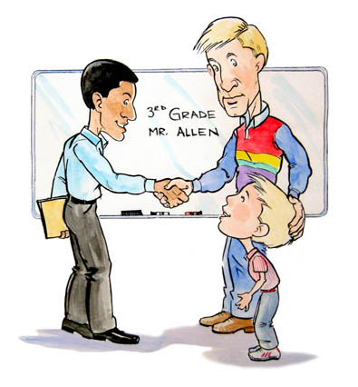
P
Parent teacher Conferences
Conferences are held during October and February. Kindergarten conferences are with the parents & the teacher. Please feel free to request a conference throughout the year whenever you feel it is necessary.

Slide 26
Q
Questions-During the school year you may have questions or concerns. Our preferred method of communication is email. Email will be checked before school, at 12:30 and afterschool. You may email me at sbrettmann@bluevalleyk12.org

Slide 27
R
Report Cards-Your child will receive 4 report cards online during the year. Please keep in mind that each child develops at his or her own rate. Childhood is a journey not a race.
Restrooms-Our restrooms are right in our rooms. Your child is allowed to go whenever needed but we do encourage them to go during group restroom breaks.

Slide 28

S
Star Student
Each child will have a week to display information about him/herself and family on our special bulletin board. Three posters will be sent home the Friday before for the child to decorate and attach photos. Please send all items back on Monday. The Star Student gets to be the line leader for the entire week.

Slide 29
T
Take Home Books
Your child will have a book bag with a book enclosed that he/she will bring home weekly. There is a specific list of directions on the bag for the child/parent to follow. The bag, along with the book, should be returned on Friday or Monday. The books are written using the sight words we need to know for Kindergarten. Each week a new book will be sent home.

Slide 30

V
Virtues
We incorporate the Blue Valley virtues in our c classrooms. Our virtues are: Responsibility, Respect, Honesty, Perseverance, Self-Discipline, Compassion and Courage.
.

Slide 31
W
Writing Skills
You will be excited to see the progression of your child’s writing skills in Kindergarten. They will begin by hearing beginning sounds in words, then the beginning and ends, and finally they will hear middle sounds as well. We will also focus on proper letter formation. Please help remind your child the correct way to hold a pencil, and to always start making their letters and numbers from the top.

Slide 32
Y
Yearbook
Yearbooks will be passed out at the end of the year. You may order a yearbook in the next few weeks.
Yummy Snacks
We have snack time everyday for 15 minutes. Each student is responsible for bringing their own eater-friendly snack and it must be nut-free.

Slide 33
Z
ZZZZ’s – Your child should get plenty of rest each night. Kindergarten students require 10-12 hours of sleep a day. It is important for your child to be alert and ready to learn each day. Set a bedtime and be consistent.

Slide 34

Thank-you for coming.
If you have additional questions, please contact me.

